Slide 1
War Surgery ICRC
Dr.AbdulWAHID M Salih
Ph.D. Surgery

Slide 2
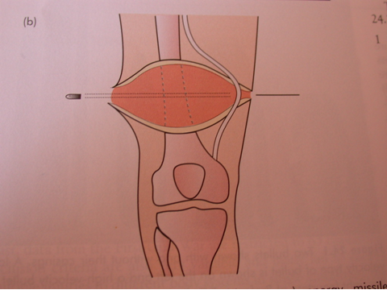
INTRODUCTION AIRWAY BREATHING

Slide 3
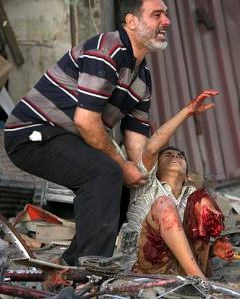
The aims of war surgery
• save life;
• avoid infectious complications;
• save limbs;
• minimize residual disability.

Slide 4
The outcome is influenced by:
• type of injury;
• general condition of the patient;
• first aid;
• time needed for transport to hospital;
• quality of treatment (surgery, post-operative care, rehabilitation);
• possibility of evacuation to a better equipped hospital with more experienced staff.

Slide 5
Death
The first aid are to prevent death and to avoid further injury.
Most deaths are caused by loss of cardio-respiratory function and from haemorrhage

Slide 6
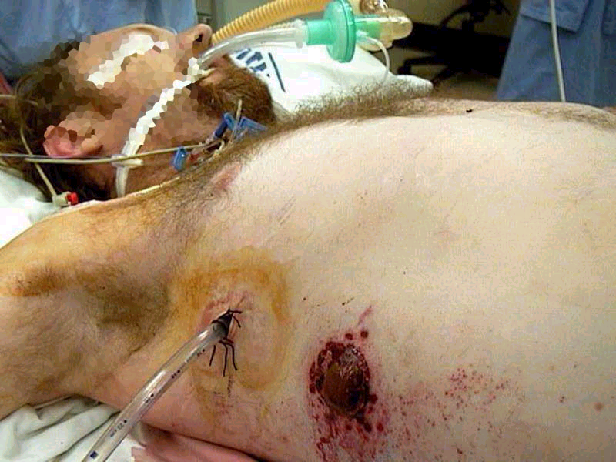
First aid
•
Airway;
•
Breathing;
•
Circulation.

Slide 7
BASIC TREATMENT
Penicillin 5 mega-units 6-hourly
I.v. fluids (Ringer Lactate or Hartmann’s solution)
Antitetanus toxoid vaccine
Analgesics can be given i.v., i.m., as suppositories or orally.

Slide 8
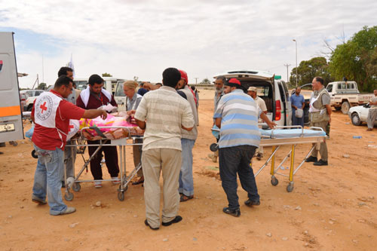
EVACUATION
The patient’s condition should be stabilized before evacuation.
Skilled first aid at the site of injury allow stability
Delay in evacuation will contribute to an increase in mortality.

Slide 9
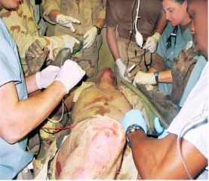
In the hospital
more skilful resuscitation can be done in the hospital.

Slide 10
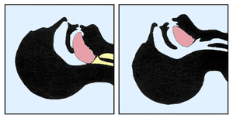
Respiratory obstruction
Aspiration of blood
vomitus
foreign bodies:
loose teeth
dentures
food
blood clot
Obstruction by the tongue
Oedema of the pharynx or larynx caused by inhalation burns

Slide 11
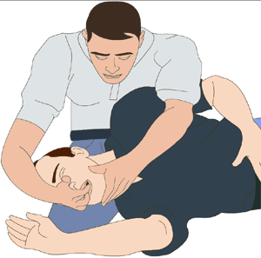
The airway must be cleared by
removing debris and foreign bodies from the mouth and oropharynx:
manually
suction.

Slide 12
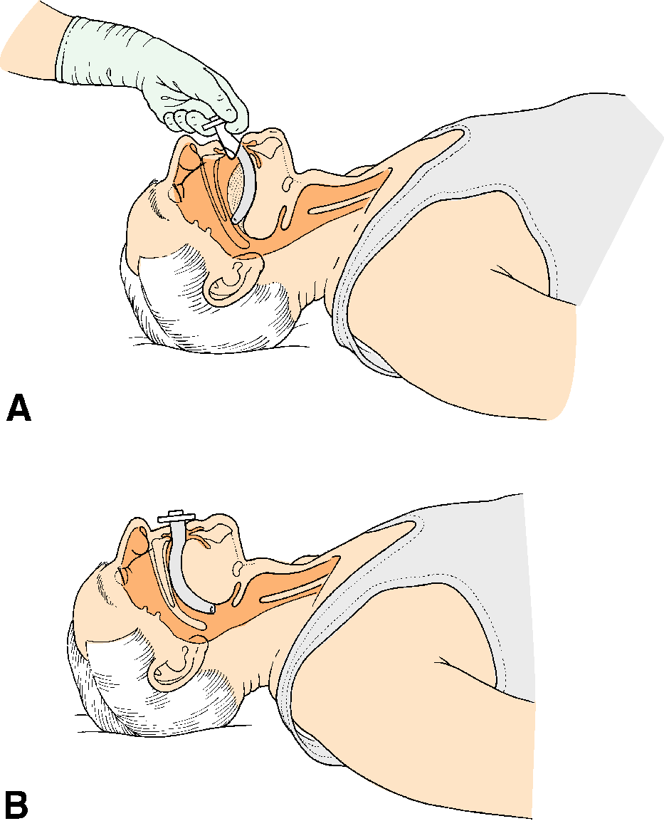
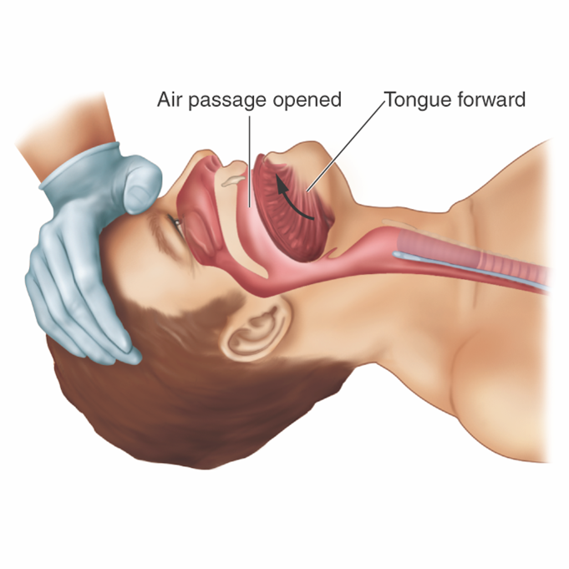
Obstruction by the tongue:
controlled by extending the neck
placing the patient in the semi-prone position.
An oropharyngeal airway.

Slide 13
Airway & breathing
The simplest methods;
mouth to mouth (specially designed oropharyngeal airway with a mouthpiece for use by the rescuer)
mouth to nose method
An Ambu bag should be
used if available artificial
ventilation on an Ambu bag commenced.

Slide 14
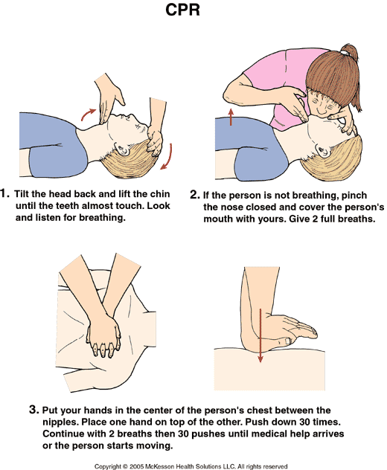

Slide 15
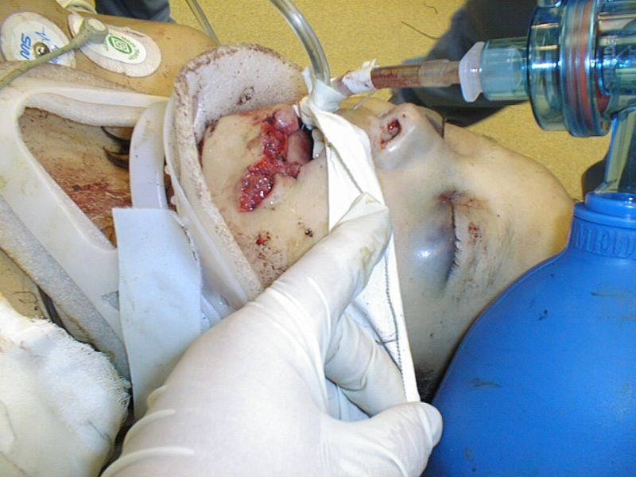
Endotracheal tube
If control is still not obtained
Deeply unconscious patients
Oedema of the pharynx or larynx

Slide 16
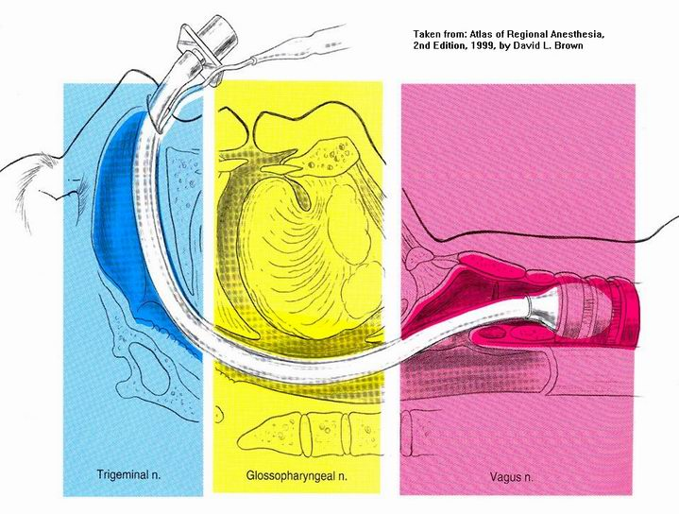
Endotracheal tube
Intubation usually requires sedation.
Diazepam (5-10 mg) given iv

Slide 17
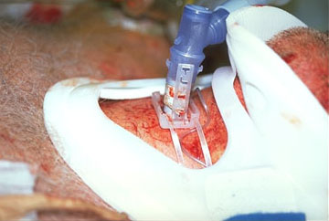
Cricothyroidotomy
Quick
safe
and relatively bloodless
In an emergency, is the treatment of choice
is preferred to tracheostomy,

Slide 18
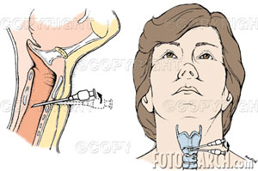
Needle cricothyroidotomy
is preferred in
an emergency situation
in a child under twelve.
use a large i.v. cannula (gauge 14) inserted into the trachea below the point of obstruction.
effective for about 45 minutes. A more definitive
airway is then required.

Slide 19
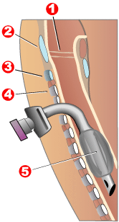
Tracheostomy
should be an elective procedure.
The only specific indication for emergency tracheostomy in missile wounds is direct laryngeal injury.

Slide 20
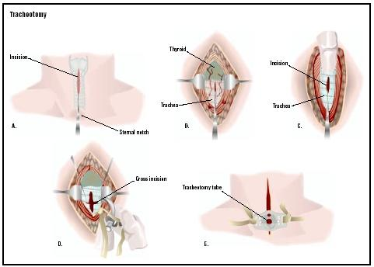

Slide 21
Breathing
Pneumothorax
Tension pneumothorax
Haemothorax
Flail segment of the chest
Haemopericardium

Slide 22
Penetrating chest wounds
may have a serious effect on:
respiration
heart
mediastinal structures

Slide 23
penetrating chest injuries
More than 90% of all can be managed initially by chest drain.
The incidence of concomitant abdominal injuries varies, ranges between 10% and 40%.
the most common operation
wound excision
chest tubes
laparotomy.

Slide 24
pneumothorax
Less than 20% of patients with penetrating war injuries of the chest
some degree of haemothorax.
Air leaks will not be large if only the pulmonary parenchyma is injured.
When full lung expansion and pleural apposition is achieved, the leak will cease within two or three days.

Slide 25
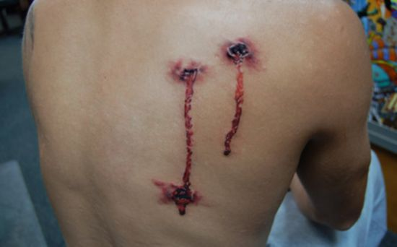
Open pneumothorax
Air passing in and out of the pleural cavity,
and bubbling through the blood coming from the wound

Slide 26
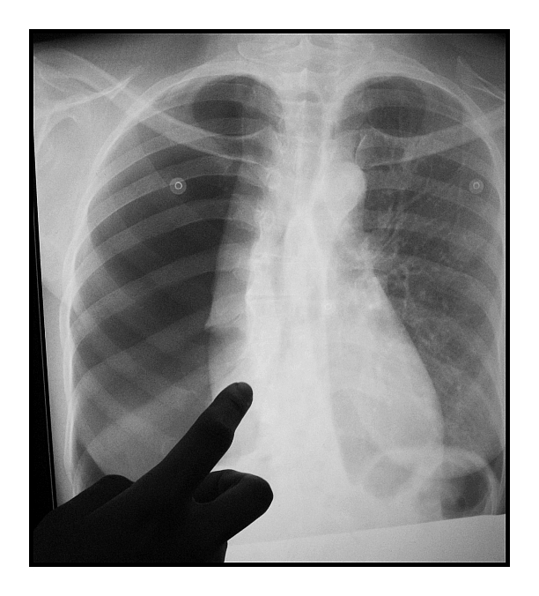

Slide 27
Pneumothorax treated by
An airtight sealed dressing (vaseline gauze or plastic sheeting) covered with a bulky dressing, firmly taped into place.
An intercostal drain.
Positioned with the uninjured side uppermost, thus allowing optimal ventilation of the undamaged lung.

Slide 28
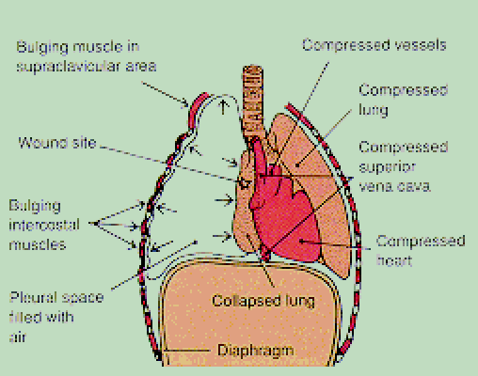

Slide 29
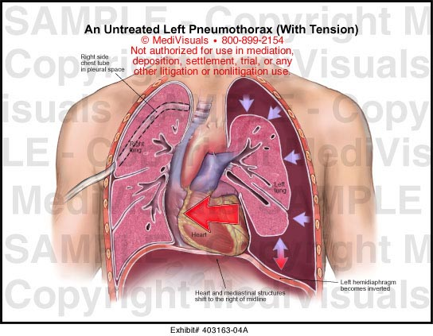
A tension pneumothorax
is an acute emergency
from penetrating chest wounds
It more commonly occurs
when a sucking chest
wound has been
sealed by an
occlusive dressing

Slide 30
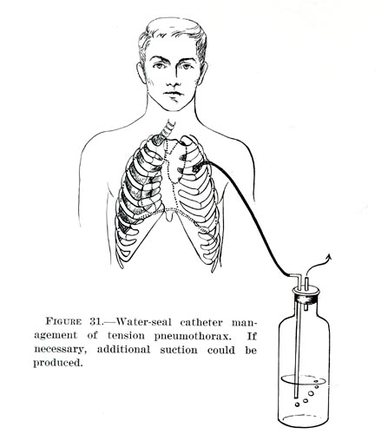
A tension pneumothorax
large bore needle, inserted in the second intercostal space in the mid-clavicular line

Slide 31
mid-clavicular (apical) chest tube
be inserted into the second space anteriorly for
pneumothorax
tension pneumothorax,
attached to;
a Heimlich one-way valve.
an underwater seal.
should be done before X-rays are taken
An X-ray one or two hours after inserting.
X-ray is checked daily.

Slide 32
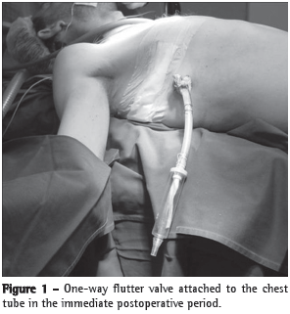
a flutter valve
mid-clavicular (apical) chest tube
widebore needle
or size F 20 or F 24 tube
second intercostal space
advanced upwards to the apex
mid-axillary (basal) chest tubes

Slide 33
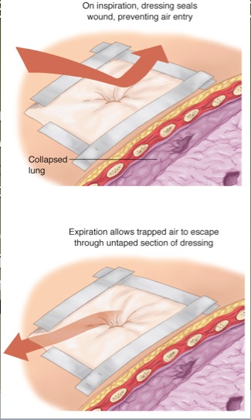
seal the wound
sealed with an airtight dressing.
a wet bulky dressing
securely fixed in place
(more effective seal can be
made using vaseline gauze}

Slide 35
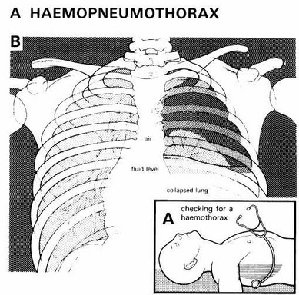
A haemothorax
Blood in the thoracic cavity rarely clots
defibrinogenate the blood by its movements.
drained using
a widebore chest tube.

Slide 36
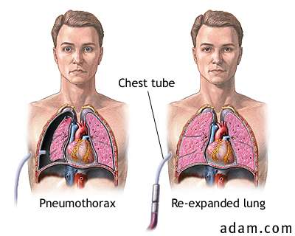

Slide 37
Removal of chest tubes
the lung has re-expanded
drainage is very small (less than 75 ml/24 hours);
(b) radiographic evidence that the lung has adequately expanded
and collections have drained to a minimum
(c) the underwater seal has stopped swinging, but is not blocked.
Clamp the drains for one more day.
the patient perform a Valsava manoeuvre when the tube is removed

Slide 38
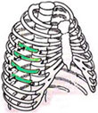

Slide 39
A flail segment
may well result from closed injuries,
number of ribs broken results in an unstable segment of chest wall
consequent paradoxical respiration.
bruised poorly functioning lung, Lung contusion for 2-3 days and will resolve slowly
Aspiration at the time of injury is
common, resulting in obstructive atelectasis

Slide 40
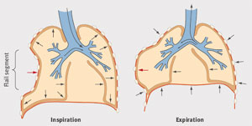

Slide 41
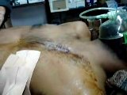
A flail segment
firm Elastoplast strapping of the affected segment
A few heavy sutures tied
over a plaster of Paris slab
Positioning; the damaged segment is against the ground,uninjured side uppermost to allow optimal ventilation of the good lung.

Slide 42
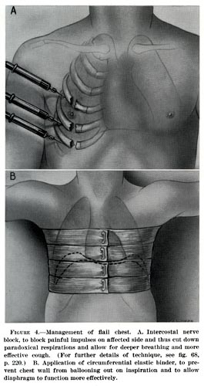
A flail segment
nerve blocks reduces
the effort of breathing
can be stabilized by
skeletal traction

Slide 43
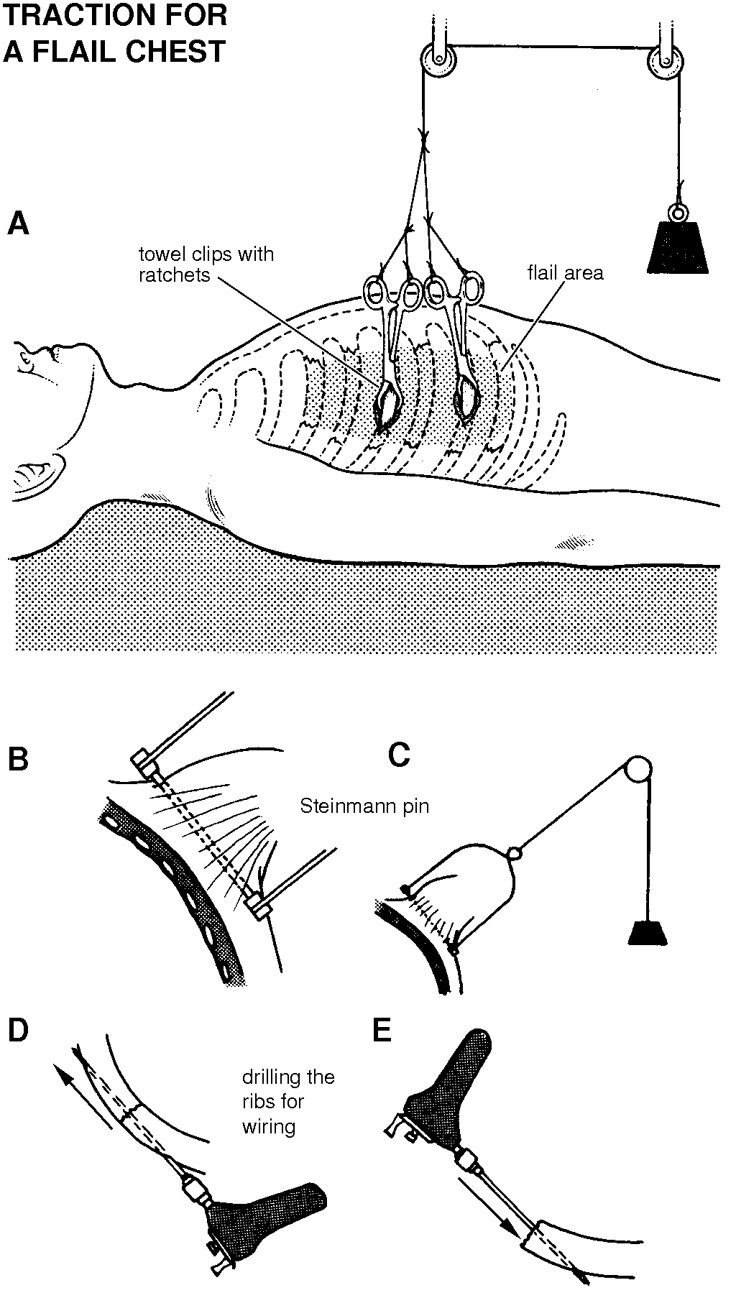

Slide 44
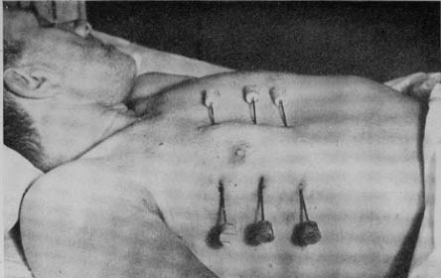

Slide 45
Postoperative controls
the patient should be checked several times a day.
Deep-breathing exercises by a trained physiotherapist,
Adequate pain relief is essential.

Slide 46
The indications for thoracotomy :
massive bleeding (more than 1000-1500 ml at the time of insertion of chest drains,
200-300 ml/hour for 5 hours);
persistent pleural air leak over 24 hours,
or earlier if massive;
mediastinal injury;
major defect of the chest wall.

Slide 47
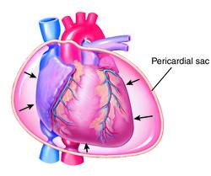
constrictive haemopericardium
In the rare
due to a penetrating
missile wound of the heart,

Slide 48
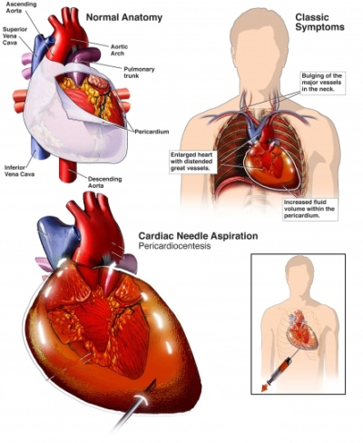
constrictive haemopericardium
immediate pericardiocentesis,
repeated if necessary
emergency thoracotomy

