Slide 1
Respiratory failure (RF)
Respiratory failure refers to a condition in which pulmonary gas exchange fails to maintain normal arterial oxygen and carbon dioxide .
Respiratory failure is a condition in which the respiratory system fails in one or both of its gas-exchanging functions- i.e., oxygenation of, and carbon dioxide elimination from, mixed venous (pulmonary arterial) blood.
Ventilation:The act of Breathing in (inhaling) which brings in oxygen from the atmosphere into the lungs and the act of Breathing out (exhaling).
Respiration: Is the process of gas exchange between the environment and the tissue level of the human body.
Respiratory failure is a syndrome of inadequate gas exchange due to dysfunction of one or more essential components of the respiratory system: CNS or Brain Stem, Nerves, Chest wall, Airways, Alveolar– capillary units, Pulmonary circulation and pleura.
Respiratory muscles:
Inspiratory Ms expand the rib cage and drive airflow into the lungs.
Expiratory Ms depress the rib cage and force air out of the lungs.
Inspiratory Muscles:
The sternocleidomastoid elevates the sternum
The scalenes elevate the top two ribs
The external intercostals move the ribs upward and outward, expanding the rib cage.
The diaphragm is the primary inspiratory muscle
Expiratory Muscles
Internal intercostal muscles pull the ribs downward and inward, reduce the diameter of the rib cage.
-Abdominal muscles depress the lower ribs, and elevate the diaphragm up and into the thorax.
Inspiration ( expanding the diameter of the thorax and force air into the lungs): pressure in the lungs becomes lower than the pressure in the atmosphere.
Expiration ( reduses the diameter of the thorax, and force air out of the lungs ), pressure in the lungs is higher than the pressure in the atmosphere

Slide 2
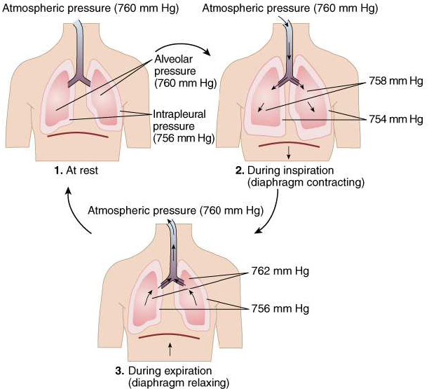
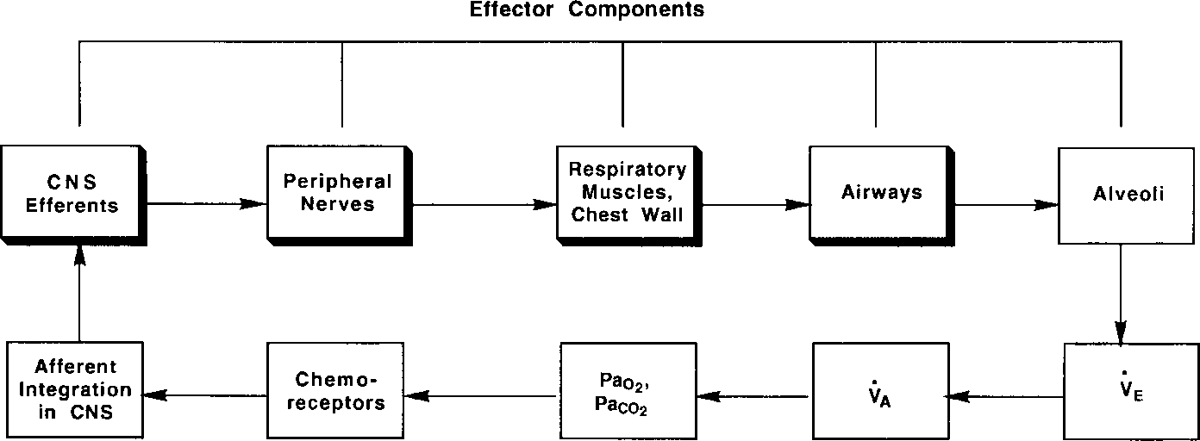

Slide 3
Respiratory failure can arise from an abnormality in any of the “effector” components of the respiratory system.
CNS: Resp. Center drive depression
Drugs
Metabolic encephalopathy
CNS infections
Increased Intra Cerebral Pressure
Obstructive sleep Apnea
Central alveolar hypoventilation
Spinal cord:
Trauma
Transverse myelitis
NeuroMuscular Diseases
Post Polio syndrome
Tetanus
Multiple Sclerosis
M.Gravis
Guillain-Barre
Critical care or steroid myopathy
Chest wall:
Kyphoscoliosis
Obesity
Upper airways :
Obstruction from tissue enlargement
Infection
Mass
vocal cord paralysis
Tracheomalacia
lower airways :
Bronchospasm
Infection)
lung parenchyma, alveoli
Infection
Interstitial lung diseases
Cardiovascular system
A variety of pharmacologic, structural, and metabolic disorders of the central nervous system (CNS) are characterized by suppression of the neural drive to breathe in the medulla oblongata. The resultant hypoventilation and hypercapnia may be acute or chronic.
An overdose of a narcotic or sedative properties is a common cause of respiratory failure. Acute overdose, long-standing use of some agents (e.g., methadone) may result in chronic hypercapnia.
“Structural” CNS abnormalities include meningoencephalitis, localized tumors or vascular abnormalities of the medulla, and strokes affecting medullary control centers.
Metabolic disorders may produce hypercapnia , examples myxedema, hepatic failure, and advanced uremia. A common clinical setting in which elevation of Paco2 is observed is chronic metabolic alkalosis (e.g., due to diureticuse),
Obesity - HypoVentilation Syndrome (OHVS), hypercapnia due to hypoventilation on a central basis.

Slide 4
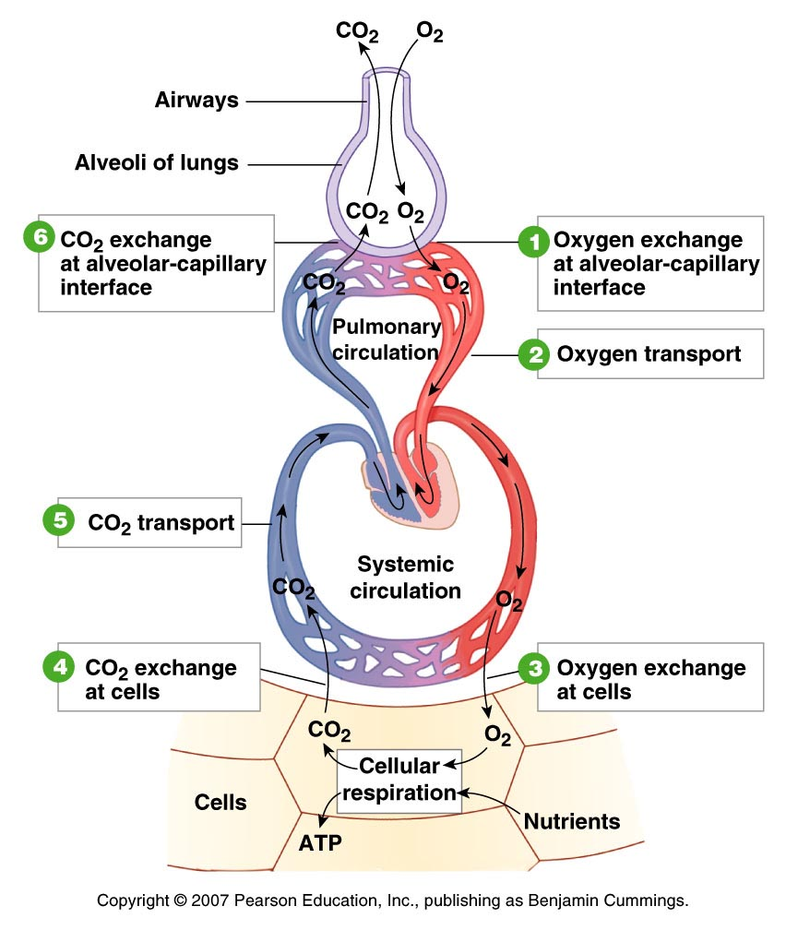
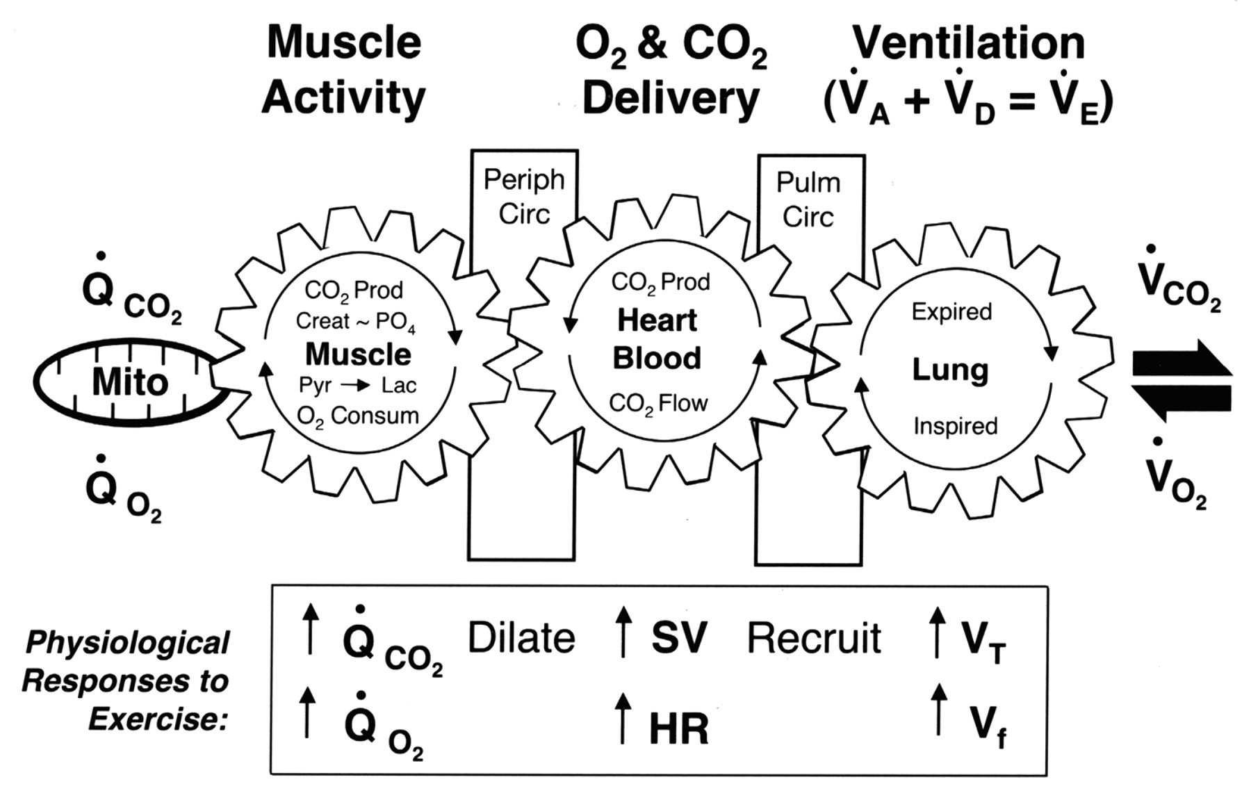
Type 1 RF:
It is typically caused by a ventilation/perfusion (V/Q) mismatch; the volume of air flowing in and out of the lungs is not matched with the flow of blood to the lungs(Failure of oxygenation).
The (V/Q) is a ratio of the amount of air reaching the alveoli (V) to the amount of blood reaching the alveoli. "Q“ and it is a measurement used to assess the efficiency and adequacy of the matching of two variables.
1 liter of blood can hold about 200 mL of oxygen.
1 liter of dry air has about 210 mL of oxygen.
The ideal (V/Q) would be about 0.9 to 1.05
The humidified air (with less oxygen), then the ideal (V/Q) would be about 1.0, thus leading to concept of (V/Q) equality or V/Q matching.
Type l respiratory failure , hypoxia depends upon balance between O2 Delivery and O2 Consumption

Slide 5
(V/Q) mismatch: V and Q of a gas exchanging unit are not matched.
The V/Q ratio: Apex of lung is higher than Base of lung.
The main reason for lower V/Q ratios at the base is that both ventilation and perfusion increase when going from the apex to the base, but Q increases more than ventilation.
The principal factor of V/Q dishomogeneity between the apex and the base of the lung is gravity.
Ventilation
Gravity and lung’s weight act on ventilation by increasing pleural pressure at the base (making it less negative) and thus reducing the alveolar volume.
At the base smaller volumes mean the alveoli are more compliant (more distensible) and so capable of wider oxygen exchanges with the external environment.
The apex, though showing a higher oxygen partial pressure, ventilates less efficiently since its compliance is lower and so smaller volumes are exchanged.
The diagnosis of acute or chronic respiratory failure begins with clinical suspicion of its presence. Confirmation of the diagnosis is based on arterial blood gas analysis
The first step in management is to determine the appropriate setting for care - admission to a standard inpatient facility or to an intensive or intermediate care unit and it depends upon :
The acuity of the respiratory failure;
The degree of hypoxemia, hypercapnia, and acidemia;
The presence of co-morbidities (e.g., cardiac or renal insufficiency);
The clinical direction that the patient takes over the first few minutes or hours of observation
.

Slide 6
RF is characterized by inadequate blood oxygenation or carbon dioxide removal.“Adequacy” is defined by tissue requirements for oxygen uptake and carbon dioxide elimination.
In the absence of bedside techniques for direct measurement of these metabolic parameters, clinicians must rely on arterial blood gas values.
Hypoxemic RF, Type l : PaO2 <55 mmHg ( < 8 kpa)
Acute, develops in minutes to hours
Chronic, develops over several days or longer
Hypercapnic RF Type ll : PaCO2 >45 mmHg ( > 6 kpa)
Acute Develops in minutes to hours
Chronic Develops over several days or longer
Type l:Hypoxia, PaO2 < 8kpa (60mmHg), normal or low PaCO2
Acute :
Acute Asthma
Pulmonary oedema
Pneumonia
Lobar collapse
Pneumpothorax
Pulmonary embolism
ARDS
Chronic:
COPD
Lung fibrosis
Lymphangitis
Carcinomatosa
R- to- L shunts
Brain-Stem lesion
Type ll, hypoxia PaO2 < 8kpa and Hypercapnia PaCO2 > 6kpa
Acute :
Acute sever asthma
Acute Severe COPD
Upper airway obstruction
Acute neuropathy
Narcotic drugs
Primary alveolar HypoV
Flail chest
Chronic:
COPD
Sleep apnea
Kyphoscoliosis
Myopathies
Dystrophy
Ankylosing spondylitis

Slide 7
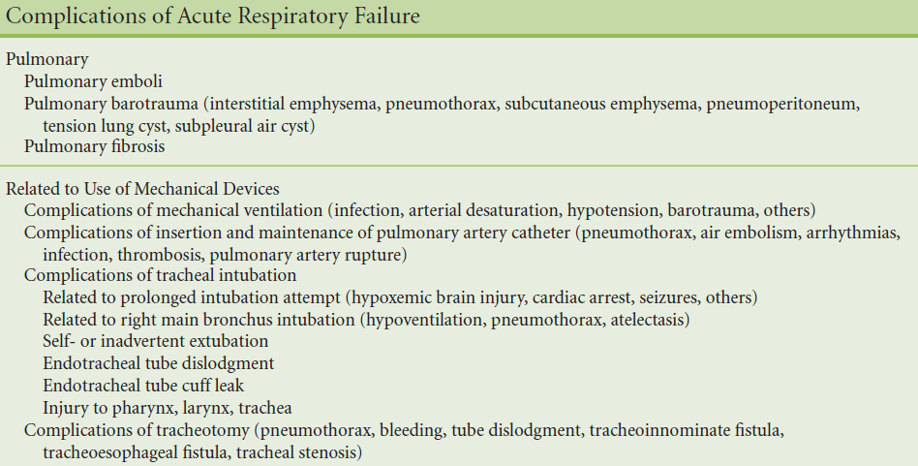
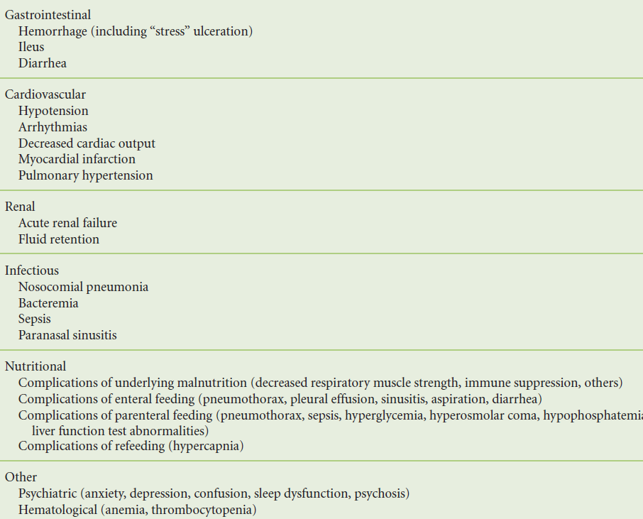

Slide 8
Morbidity and Mortality in Acute Hypercapnic Respiratory Failure
In general, several parameters presage a higher mortality in patients admitted with hypercapnic respiratory failure:
(1)the patient’s “physiological reserve,” as determined by concurrent cardiopulmonary, renal, hepatic, or neurological disease and the age;
(2) the underlying cause of the acute deterioration;
(3) the severity of the RF, as defined by arterial pH and Pco2
(4) development of complications after onset of acute respiratory failure
Older patients who are significantly more acidemic, hypotensive, or uremic appear to have a higher mortality. The magnitude of the hypoxemia or hypercapnia at the time of presentation may not reliably foretell mortality.
Causes and management of exacerbations of COPD
K. Vijayasaratha R.A. Stockley Lung Investigations Unit,University Hospital Birmingham NHS Foundation Trust, Queen Elizabeth Hospital, BH
Up to 10% of acute hospital admissions in the UK are the result of exacerbations of COPD
BTSociety reported that 20% of annual deaths are due to respiratory diseases and almost 25% due to COPD.
Mild: those requiring an increase in usual therapy.
Moderate: those requiring the introduction of antibiotics and/or steroids.
Severe: those needing hospital admissions.

Slide 10
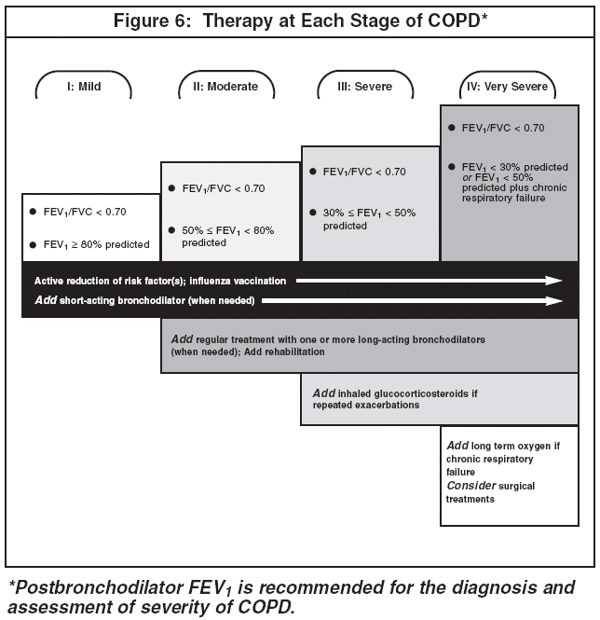

Slide 12
Management of RF:
Diagnose and manage the underline causes.
ABG is mandatory in the assessment of the initial treatment.
History of the present illness from the patient or from a company person.
Opiate antagonist is occasionally successful.
Don’t delay intubation.
Sedative poisoning or CO2 narcosis, eventually coma, is a primary failure of neurological drive and don’t forget (Intra Cerebral Hemorrhage or head injury).
Type l RF, O2 therapy high concentration 40-60 % or more FIO2 which increases the alveolar PaO2 in poorly ventilated lung unit.
Patients need high concentration more than 60% should receive humidified oxygen.
For COPD 24-28% oxygen by venturi mask to avoid worsening the condition.
At the Emergency Room (ER)
Initial treatment, the degree of severity and further planning takes place at the ER.
On call physician ( pumlmonologist, internist, or anesthesiologist) should be contacted in case of NIV or intubation.
When the patient has been transferred from ER, the next post must be registered and well planned.
Is it Type I or type II respiratory failure?

Slide 13
Group A: ICU and most probably intubation:
PaCO2 narcosis or pH <7.20
Unstable hemodynamic status. (shock
Life-threatening arrhythmias (VF) or recurrent (VT)
Mental unstable, irritable, panic status, facial trauma and unfitness for mask therapy)
Worsening of the clinical status after a few hours of NIV therapy (unsuccessful NIV).
PaO2 <7 kPa despite maximal FiO
General tiredness, respiratory muscle weakness and intolerable clinical status. Breath frequency > 30. BPM
Group B: Internal M.ICU, CCU, intermediate post
Acute RF type 1: hypoxia- First choice - CPAP.
PaO2 <8 kPa. Normal pH and PaCO2.
Pneumonia. Sepsis (Multiorgan dysfunction syndrome- MODS).
Pulmonary embolism
Acute Heart Failure ( pulmonary edema)
Acute Asthma Attacks
FiO2%: Start with the high level 100%, then step down gradually .
CPAP (2,5 cmH2O to 10 cmH2O), will increase gradually to the pressure that gives the desired effect.

Slide 14
Indacterol-Onbrez, 150-300ug x1
Spiriva 18ug daglig.
Daxas, Roflumilast 500ug x1 PDE4
Inuxair\Innovair 100mg Beclo+6ug Formoterol

Slide 15
Acute RF: B- pH under 7.35
Chronic RF :B- PaCO2 over 6 kpa
Assessment and management of Acute RF
Acute RF type 1
Acute RF type ll
Assessment and management of Acute on Chronic RF
Assessment and management of Chronic RF

Slide 16
AR Type II – hypercapnia- First choice NIV
PH <7.35 and PaCO2 high, but PaO2 low or normal.
Acute on chronic respiratory failure (pH <7.35 and PaCO2 high and low or normal PaO2).
Acute exacerbation of COPD.
Group C: Medical ward / lung clinic. For conventional therapy.
Acute RF that does not meet the criteria in Group A and B.
-Patients must be monitored closely with ABG and should be observed the first few hours in case of reevaluate the treatment concerning (Rescue CPAP or NIV).
Contraindications of NIV:
- Comatose patient.( not hypercapnic comatose syndrome).CO2 narcosis.
- Facial injury, surgery, deformity.
- Recent upper abdominal operation.
- Poor compliance and panic
- Patient communication- failure.
- Hemodynamic Unstable, severe arrhythmias
- Massive upper airway secret stagnation.
- Serious bulbar dysfunction
- Acute severe upper gastrointestinal bleeding
- Pneumothorax (with chest tube is not contraindicated).
- Acute sinusitis.

Slide 17
NIV Setting:
Mode = ST ( Spontaneous Timed).
IPAP( Inspiratory positive Airway Pressure) = 12 cmH2O
EPAP( Expiratory positive airway Pressure) = 4 cmH2O
RF = 12 - 15 or 5BPM under the patient's own
IPAP min: 0.1 msc
IPAP max: See table on the machine accordingly.
Rise Time: 150 msc for COPD and more than 300 msc for NMD
Trigger: mild, moderate and high.
Cycle: mild, moderate and high.

Slide 18
