Slide 1
Medical
Helminthology

Slide 2
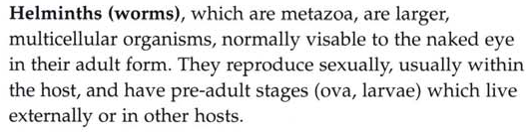

Slide 4
Nematohelminthes
Nematodes (round worms)
sexes separate -Un segmented,
-Possess mouth, esophagus, intestine and anus.

Slide 5
Monogenes – have single host life cycle.

Slide 6
Platyhelminthes
Cestodes (Tape worms)
-Segmented
-Possess scolex, neck and proglottids
-hermaphroditi
-vary in length from 2 to 3 mm
to 10 m, and may have three
to several thousand segments.
-Larval forms, which are
cystic or solid, inhabit
extra intestinal tissues.

Slide 7
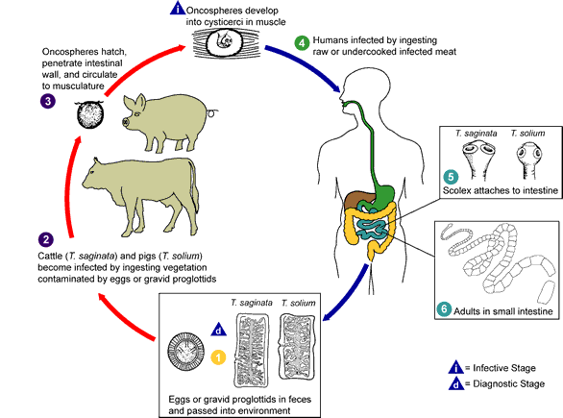
Taenia sp., life cycle

Slide 8
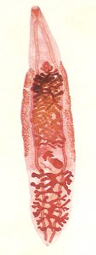
Trematodes(flukes)
Un segmented, Leaf like or cylindrical
Monoecious – hermaphroditic (contain male and
female reproductive system
Two suckers: Oral (anterior) and ventral (posterior).
Digenes – have at least two host life cycle

Slide 9
Digenes – have at least two host life cycle.

Slide 10
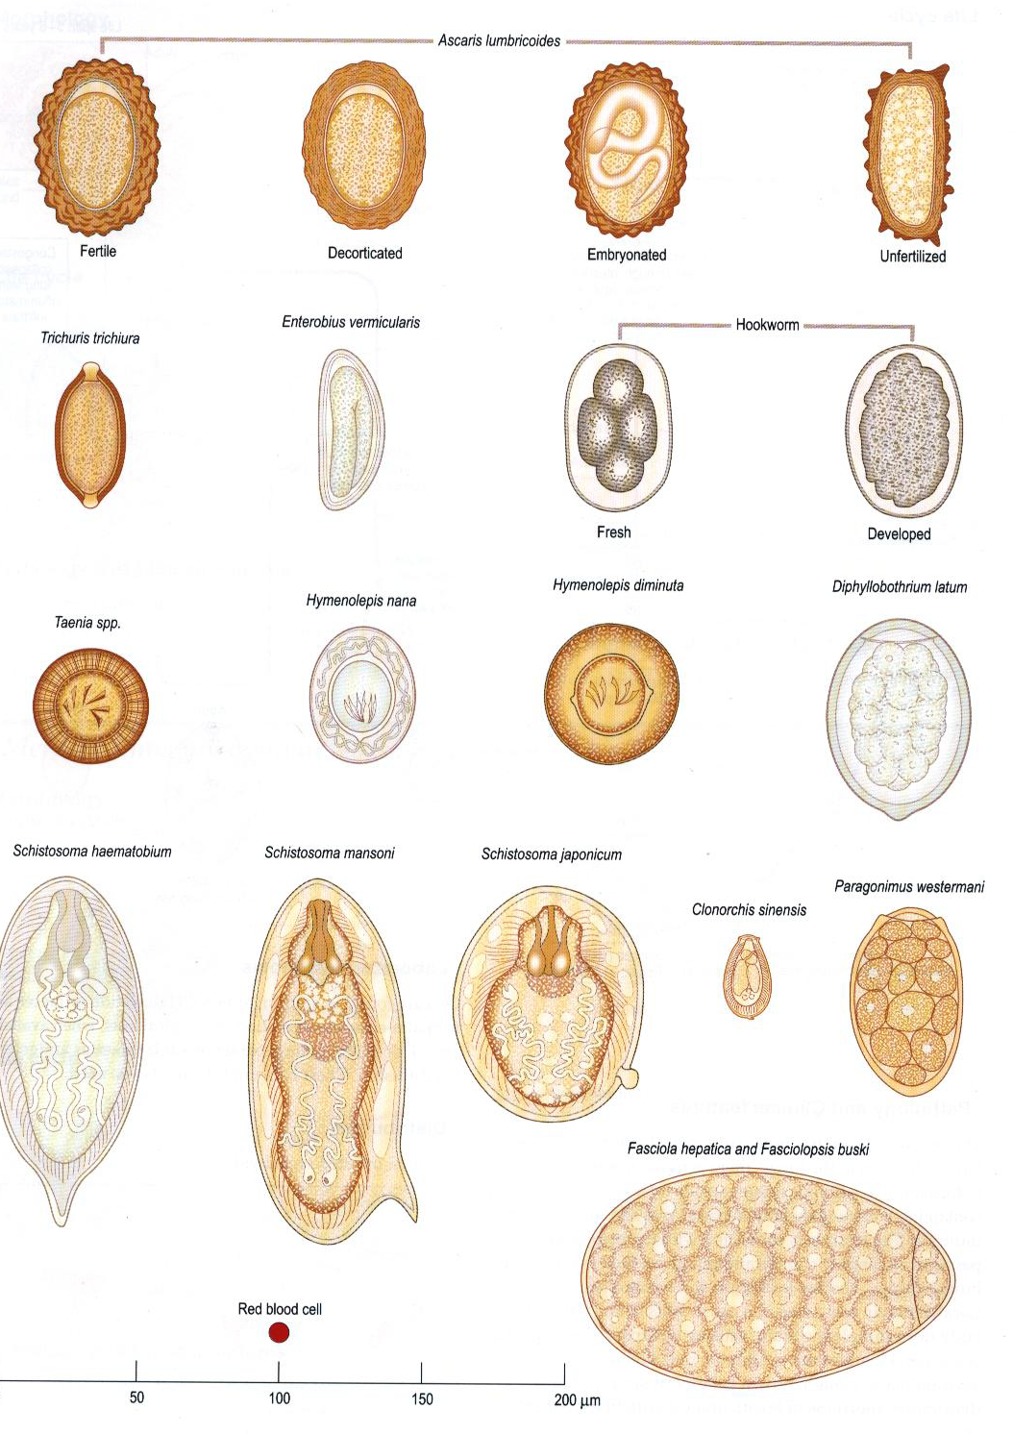

Slide 11
Nematohelminthes
Class:Nematoda

Slide 12
General characters
1) Un segmented
2) Elongated, vary in length from few mm. to more than one meter.
4) Cylindrical, round in cross section (round worms). Covered by a non-cellular protective cuticle.
5) Sexes are separate, male is shorter and thinner than female.
6) Males have ventrally curved at the posterior end.
7) Anterior end possesses lips, teeth, hooks, cutting plates or papillae for attachment to final host.
8)The digestive system
Mouth, buccal cavity, The esophagus, an important feature of nematodes, is a muscular structure that pumps food into the intestine, and ends by the anus which opens on the ventral surface

Slide 13
Development of Nematodes:
Most of the nematodes have only one host, simple life cycle, Some species have an intermediate host and complex life cycle as.
Eggs may be fully mature or immature eggs.
Nematodes have 5 stages in life cycle, 4 larval stages and the adult.
L1, L2, L3, L4, adult
the first and second stage larvae are Rhabditiform
and the third is Filariform.
Molting:
Formation of new cuticle, loosening of the old cuticle, rupturing of the old cuticle, and the escape of the larva.
Cuticle shed between each molt,
Larval development needs four moults.

Slide 14
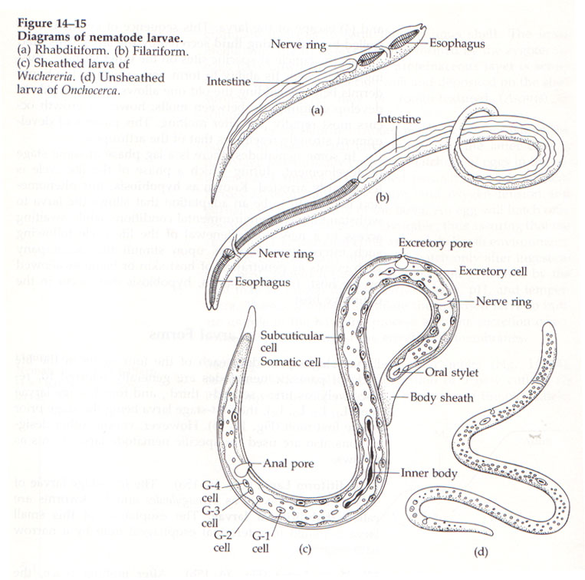

Slide 15
Routes of infection:
1- Oral (major route): Infection takes place by ingestion of infective stages as Ascaris lumbricoidis and Trichuris trichura.
2- Cutaneous :by the ability of the larvae to penetrate the skin or mucous membranes as Hook worm and Strongyloides stercoralis.
3- By an intermediate host as Filariae.
4- Autoinfection as Strongyloides stercoralis.

Slide 16
Classification: divided into intestinal and tissue nematodes:-
I.Intestinal Nematodes:- these don't require an intermediate host, infection being direct from host to host after a period of free living existence. These include :-
Ascaris Lumbricoides, Trichuris trichiura.
Enterobius vermicularis, Hook worms (Ancylostoma duodenale and Necator americanus)
Strongyloides stercoralis.
II. Tissue Nematodes :- these require an intermediate host which is usually an arthropod. These include:-
Trichinella spiralis,
Dracunculus medinensis.

Slide 17
Ascaris lumbricoides
(large intestinal roundworm)
most common worm found in human.
Geographic distribution: worldwide, but more prevalent in warm, moist soil regions of bad hygienic and under developed countries..
Occurs in all ages but it is most prevalent in the 5-9 years old
Disease: roundworm infection, ascariasis.
Habitat: small intestine.
Infective stage for human is 2nd stage larva in egg.

Slide 18
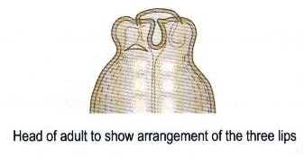
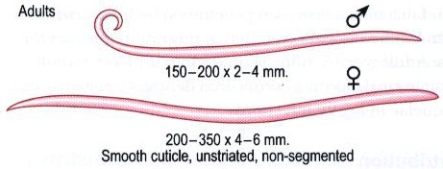
Morphology:
3- Adult (female 20-35 by 0.5 cm; male 15-20 by 0.3 cm).
2- Terminal mouth with 3 oval lips with sensory papillae
5- Curved tail of male with two spicules.
1- Both ends taper (anterior end thin).

Slide 19
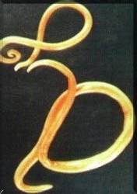

Slide 20
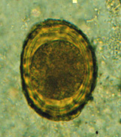
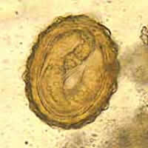
Eggs:
a) Fertilized egg:
Size : 75 × 50 µ.
Shape : oval with 2 coverings:Outer mammillated, Inner thick eggshell. Color : brownish.
Contents : immature ovum (one – cell – stage).
200 000 eggs daily output,
2 weeks

Slide 21
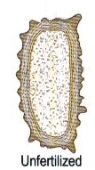
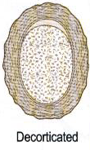
Unfertilized egg:
Laid by unfertilized female
Size: 90 in length, long and narrow
Thin egg shell, with an irregular coating of albumin
Contain granules

Slide 22
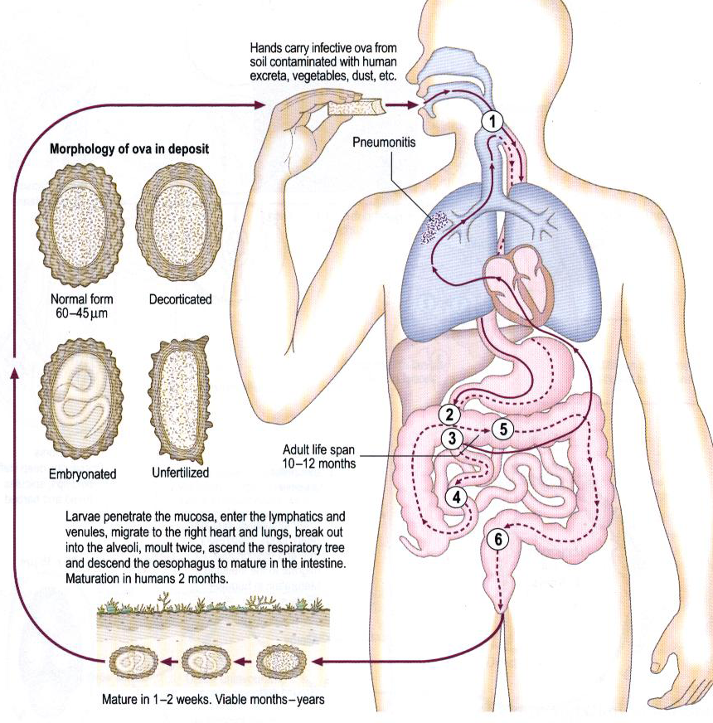

Slide 23
Pathology and clinical features:
Asymptomatic : patients infected with a small number
of worms (5-10) will often remain asymptomatic
1- intestinal stage:
obstruction of Intestinal, bile duct, pancreatic duct or appendix.
Penetrate the intestinal wall.
Migrate to the stomach and may be vomited
Can migrate out of the anus or come out the mouth or nose.

Slide 24
2- Migration stage:
Migrating larvae may lead to:
A) haemorrhages and pneumonitis
b) Allergic manifestations as asthma and oedema.
c) Fever, cough and expectoration of blood stained sputum, transient eosinophilia (Loeffler's syndrome).
d) Occasionally some larvae reach the left heart and are distributed as emboli to various organs as lymph nodes, brain, spleen, kidneys……..

Slide 25
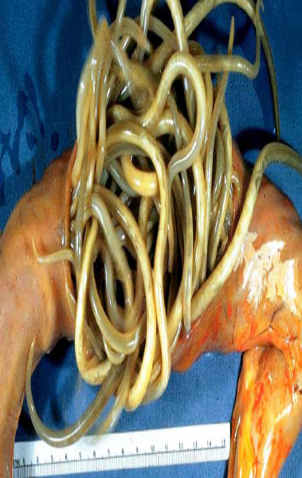
Intestinal obstruction

Slide 26
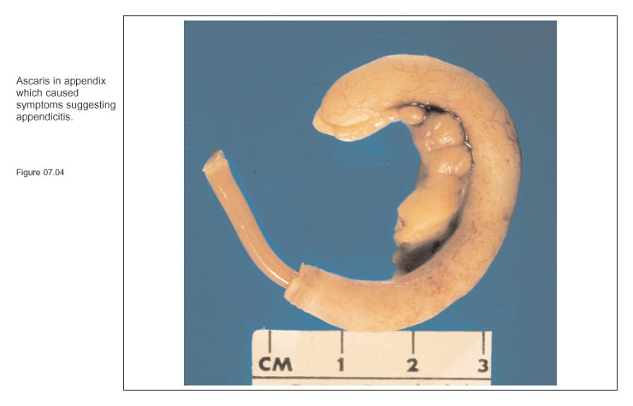

Slide 27
migrate out of the mouth or nose.

Slide 28
Diagnosis:
1) Detection of eggs in the stool, finding the adult in stool or vomited.
2) Detection of larvae in sputum.
3) High Eosinophilia is present in the larval invasion stage.

Slide 29
Prevention and control:
1) Proper washing of vegetables eaten raw. 2) Health education
3) Washing hands before meals.
4) Mass treatment.
5) Sanitary disposal of human feces.

Slide 30
