Slide 1
NEOPLASIA

Slide 2
Papilloma- Finger like projections

Slide 3
Papilloma-Fibro-vascular core

Slide 4
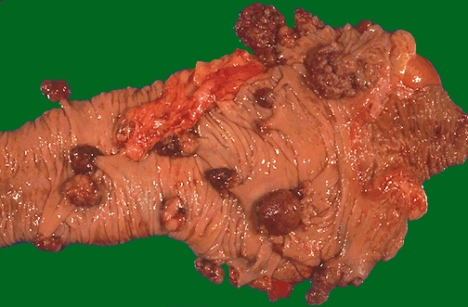
Multiple adenomatous polyps of the cecum

Slide 5
Tubular Adenoma-Colon

Slide 7
Nevus

Slide 8
Nevus

Slide 9
H. Mole

Slide 10
Lymphangioma

Slide 11
Hemangioma

Slide 12
Hemangioma

Slide 13
Hemangioma

Slide 14
Meningioma

Slide 15
Fibroma

Slide 16
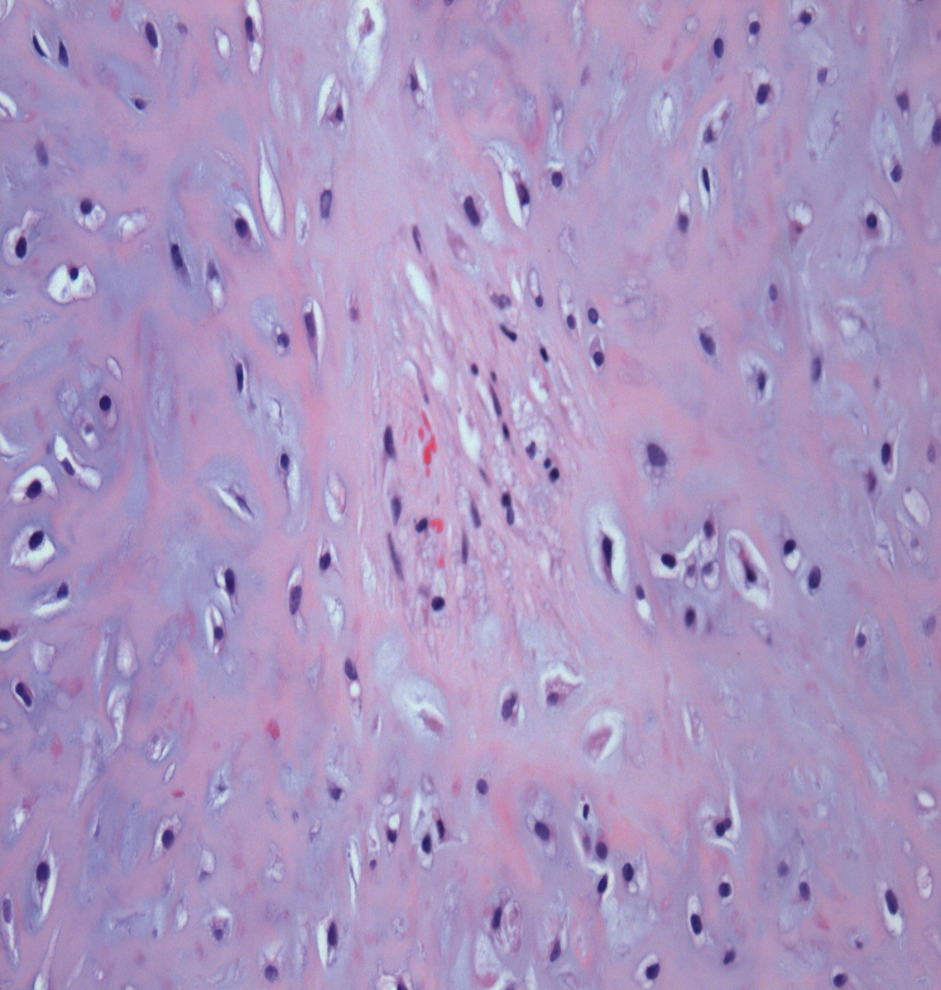
Chondroma

Slide 17
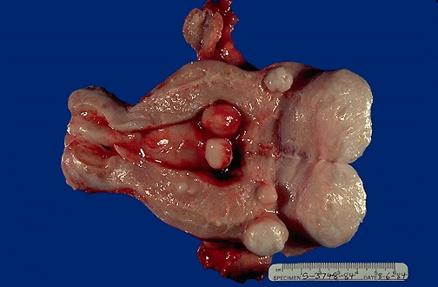
Uterus with leiomyomas

Slide 18
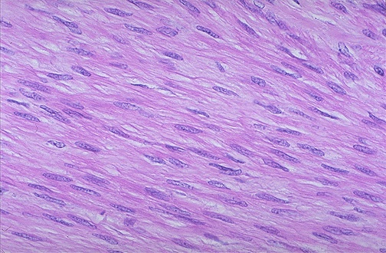
Leiomyoma-Benign looking spindle cells

Slide 19
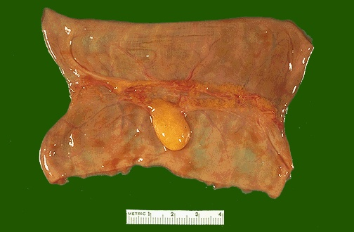
Benign lipoma on the serosal surface of the small intestine

Slide 20
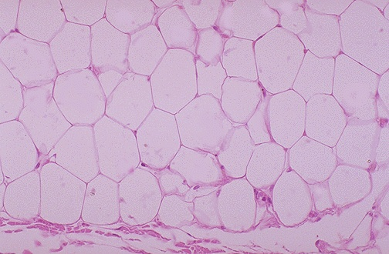
Lipoma

Slide 21
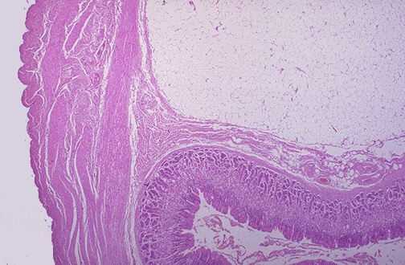
Lipoma

Slide 22
Fibroadenoma-Breast

Slide 23
Fibroadenoma-Breast

Slide 24
Pleomorphic adenoma-Salivary gland

Slide 25
Pleomorphic adenoma-Salivary gland

Slide 26
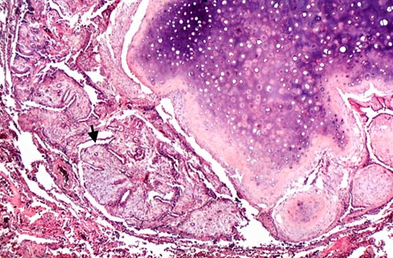
Hamartoma-Lung

Slide 27
Choristoma-Stomach

Slide 28
Gastroscopic view Ectopic pancreatic tissue

Slide 29
Dermoid cyst

Slide 30
Adenoma-Thyroid- Well circumscribed tumor

Slide 31
Squamous cell carcinoma-Well differentiated

Slide 32
Squamous cell carcinoma. The arrows pointing to?

Slide 33
Adenocarcinoma. It Is ____________differentiated

Slide 34
Adenocarcinoma. Is there any invasion?

Slide 35
Adenocarcinoma-Local invasion

Slide 36
Malignant tumor. What do you see?

Slide 37
Find any malignant criteria

Slide 38
Describe what you see

Slide 39
Tumor giant cells

Slide 40
What is this?

Slide 41
Cervical biopsy- What changes do you see?

Slide 42
Well differentiated adenocarcinoma

Slide 43
Poorly differentiated adenocarcinoma

Slide 45
Describe what you see

